Slide 1
Detection of AI generated images
Ante Čavar
Fran Lubina
Paula Moničić
Mihael Pristav

Slide 2
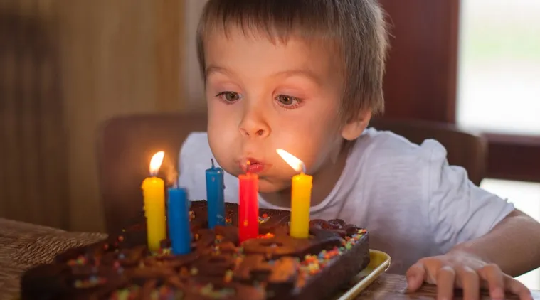
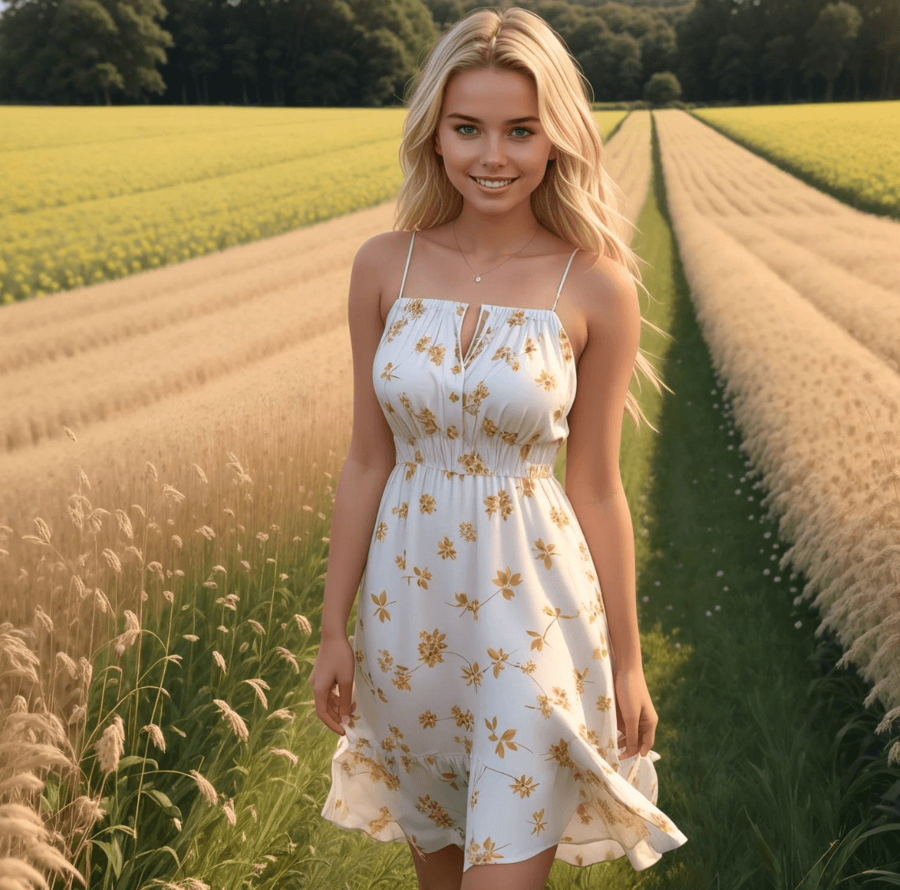
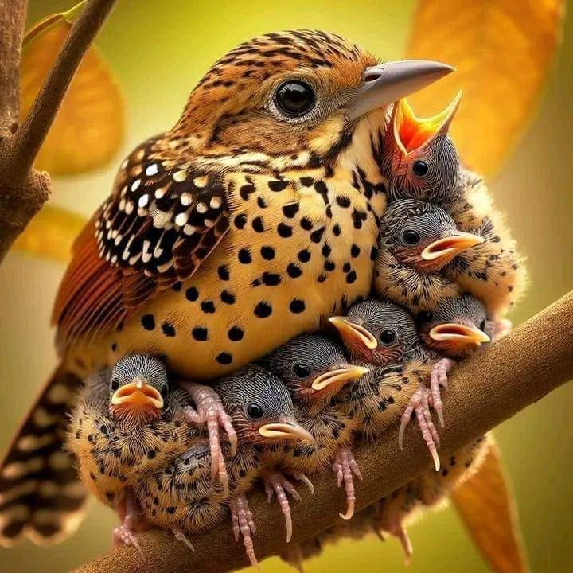
Ai generated images
AI models for image generation
Rapid advancement
Human noticeable differences
Computer noticeable differences

Slide 3
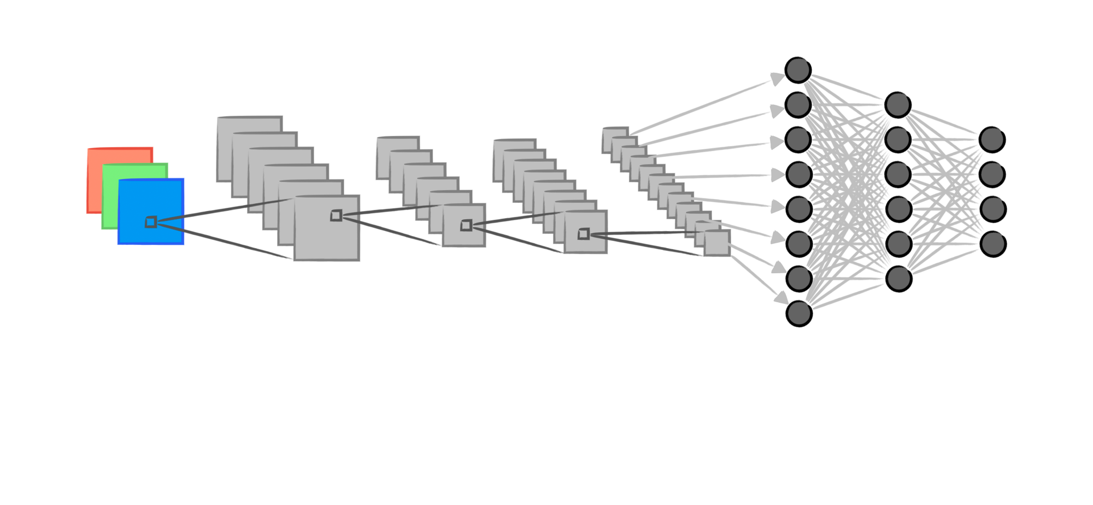
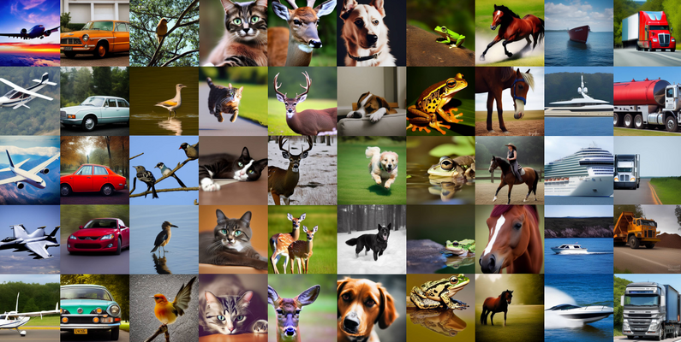
Our approach
Machine learning solution
Binary image classification (ai - natural)
Convolution neural network (CNN)
Based on CIFAKE dataset

Slide 4
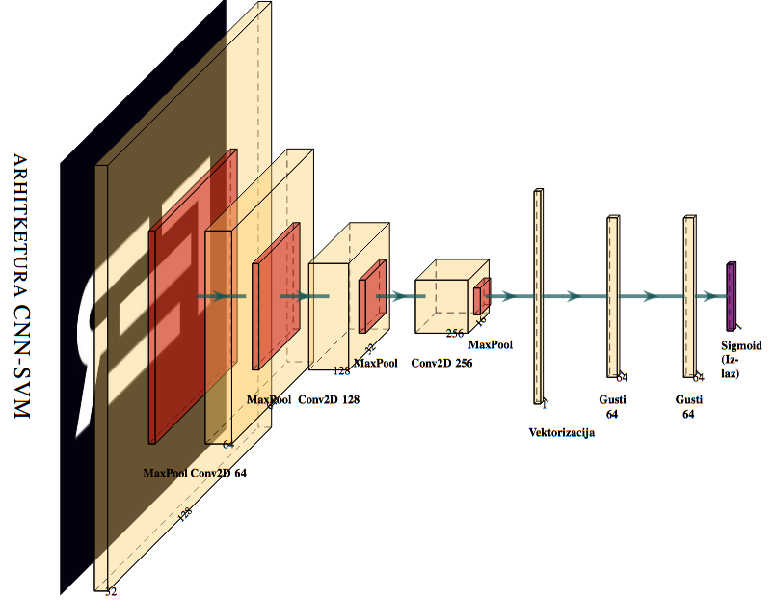
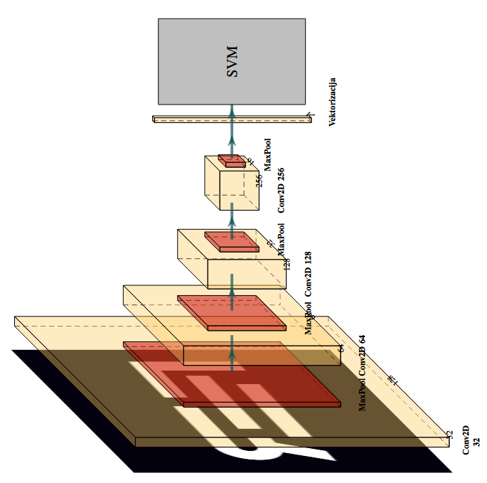
Our models
CNN with softmax activation
CNN with SVM
Linear kernel
Rbf kernel

Slide 5
Training
100 000 images
70:30 split
Resizing of images
Hyperparameter grid search
SVM: C + γ

Slide 6
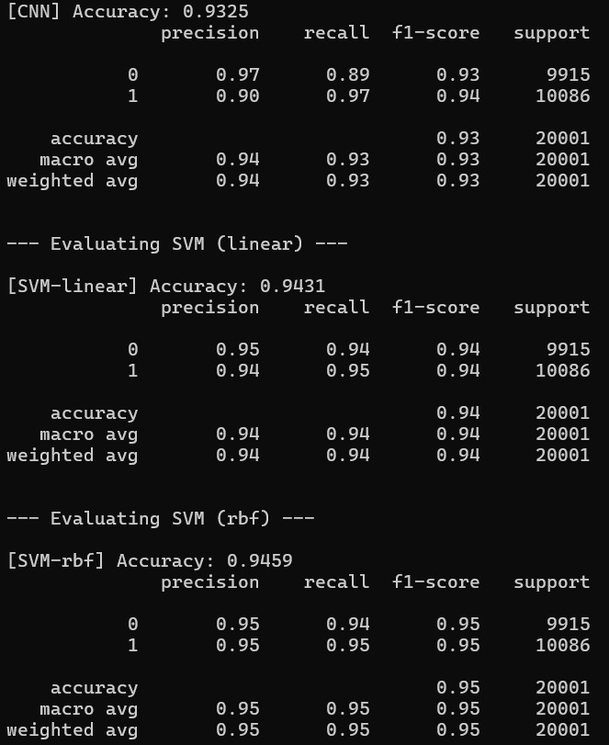
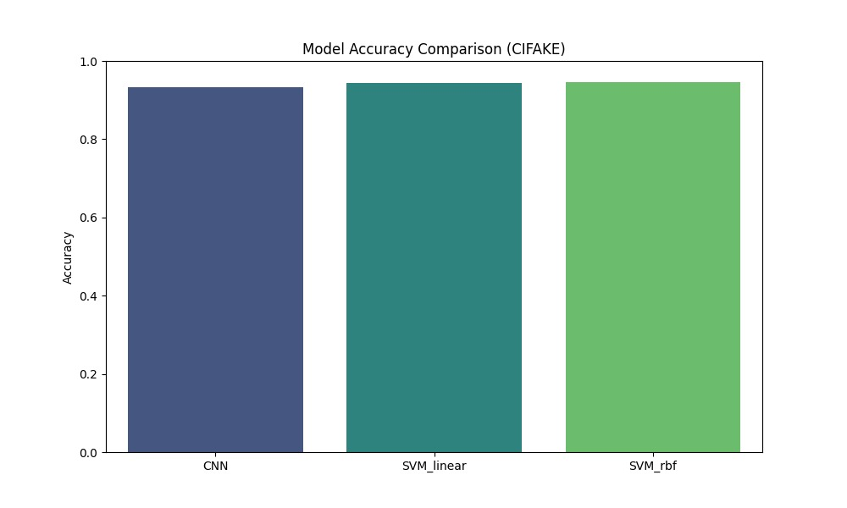
Results
High accuracy
Comparable between models

Slide 7


THE END
Any questions?

Slide 8
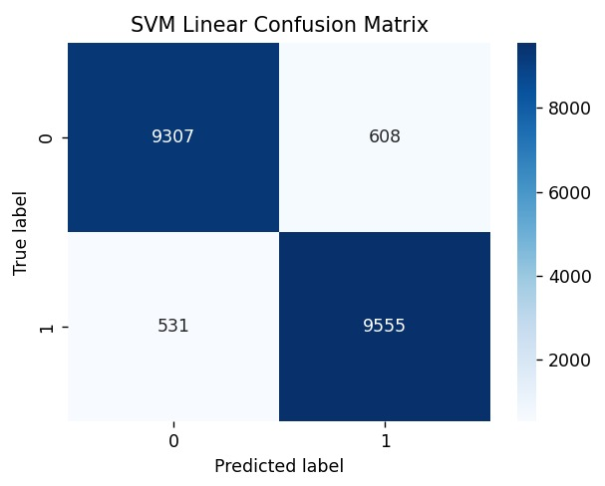
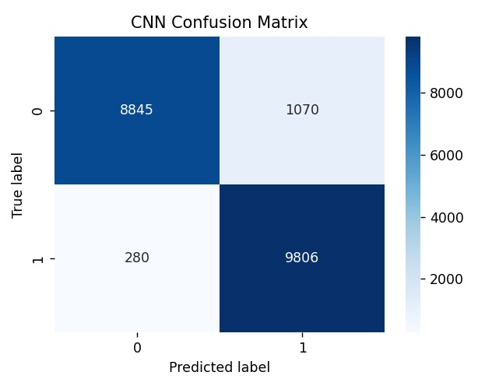
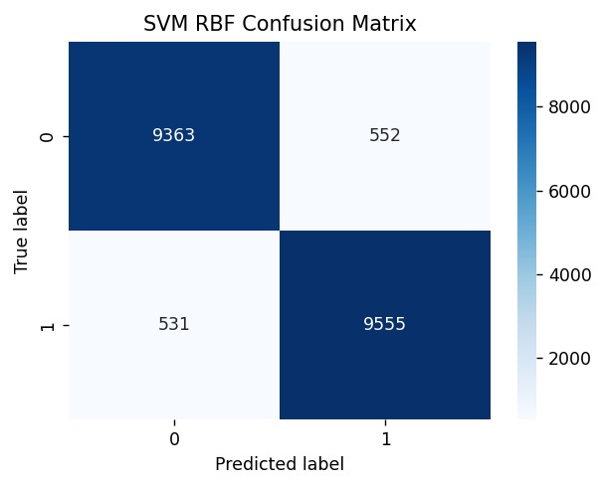
BONUS SLIDE
Confusion matrix

